Slide 1
CLASSIFICATION OF CROPS AND WEEDS USING DEEP LEARNING
Major Project
Team:
Project Guide:-
Dr. Syed Abudhagir Umar, M.E, Ph.D
Assosiate Professor
V. Vishveswar Reddy 17211A04P4
Y. Shashank Reddy 17211A04P9
K. Rakha 17211A04K7
V. Vamshidhar 17211A04P7

Slide 2
TABLE OF CONTENTS
ABSTRACT
LITERATURE SURVEY
MOTIVATION
BLOCK DIAGRAM
ALGORITHIM
LAYERS
DATASET
SOFTWARE AND HARDWARE REQUIREMENTS
SEQUENCE
CODE
TRAINING PROCESS
RESULT & ACCURACY
OUTPUT
CONCLUSION
REFERENCES

Slide 3
Abstract
Smart agriculture is an area that can benefit from the latest advances in expert systems. One of the objective is to remove the weeds by reducing the use of herbicides used, the risk of pollution of crop and water.
The image of crop field is given as input training examples. By using the extracted feature, the images with weeds are detected and classified.
A deep learning model is developed using convolution neural network to detect weeds with a good accuracy so that the model could be used to detect the weeds crop field in a shorter time.

Slide 4
Literature Survey
Al Bashish, Braik M and Bani-Ahmad S [2010] together proposed framework is image-processing-based and is composed of the following main steps; in the first step the images at hand are segmented using the K-Means technique, in the second step the segmented images are passed through a pre-trained neural network.
Huang KY [2007] presents an application of neural network and image processing techniques for detecting and classifying Phalaenopsis seedling diseases, including bacterial soft rot (BSR), bacterial brown spot (BBS), and Phytophthora black rot (PBR).
Wang H[2012] illustrates that the Digital image recognition of plant diseases could reduce the dependence of agricultural production on the professional and technical personnel in plant protection field and is conducive to the development of plant protection informatization
Dr. Ghazali Talbi [2020] propose a unified way to describe the various optimization algorithms which focus on common and important search components of optimization algorithms: representation, objective function, constraints, initial solution and variation operators

Slide 5
Motivation
One of the objective is to remove the weeds by reducing the use of herbicides used, the risk of pollution of crop and water. The image of crop field is given as input training examples. In order to predict weeds and plants data set is collected and trained using Fully connected layers.
In proposed system we are collecting dataset of weeds and plants for training purpose.
Data set is pre-processed, tested, trained and spitted and CNN model is used to train dataset and model is saved to system.

Slide 6
Block Diagram
Image Acquisition
Pre Processing
Feature Extraction
Classification
Identification

Slide 7
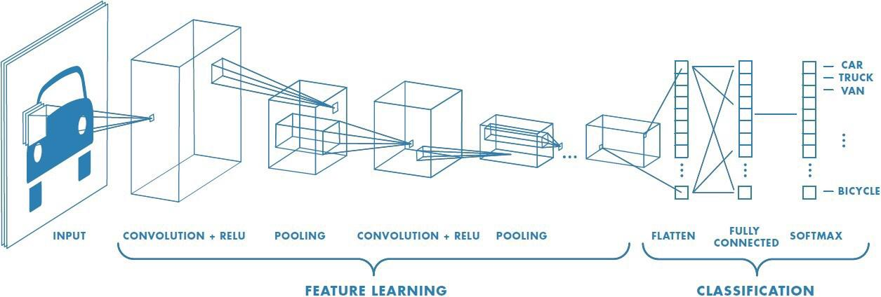

Slide 8
Algorithm
(1) Enter a sample pictures of rice diseases. The pictures are extracted from the folder
as a training sample set for input.
(2) Pre-processing. In order to improve the training efficiency, the input image is standardized to a
resolution of 224 * 224.
(3) Construct new and improved models. Using the layers present in the CNN model, the 3 FC layers are
optimized as 1 Flatten layer and 6 FC layers with reduced parameters. With a 2 label softmax classifier.

Slide 9
Algorithm
(4) Micro-transfer learning. Using the parameters of the convolutional layers and pooling layers
given by ourselves in a syntaxed manner, the parameters of the detection model were optimized by transfer learning.
(5) Model training. To train and optimize the parameters of 6 FC layers and Softmax layers, it is
necessary to freeze the parameters of 3 convolutional layers and their pooling layers and initialize the
model parameters using a random method, set the momentum parameters, the learning rate, and the
accuracy standard to iterate.

Slide 10
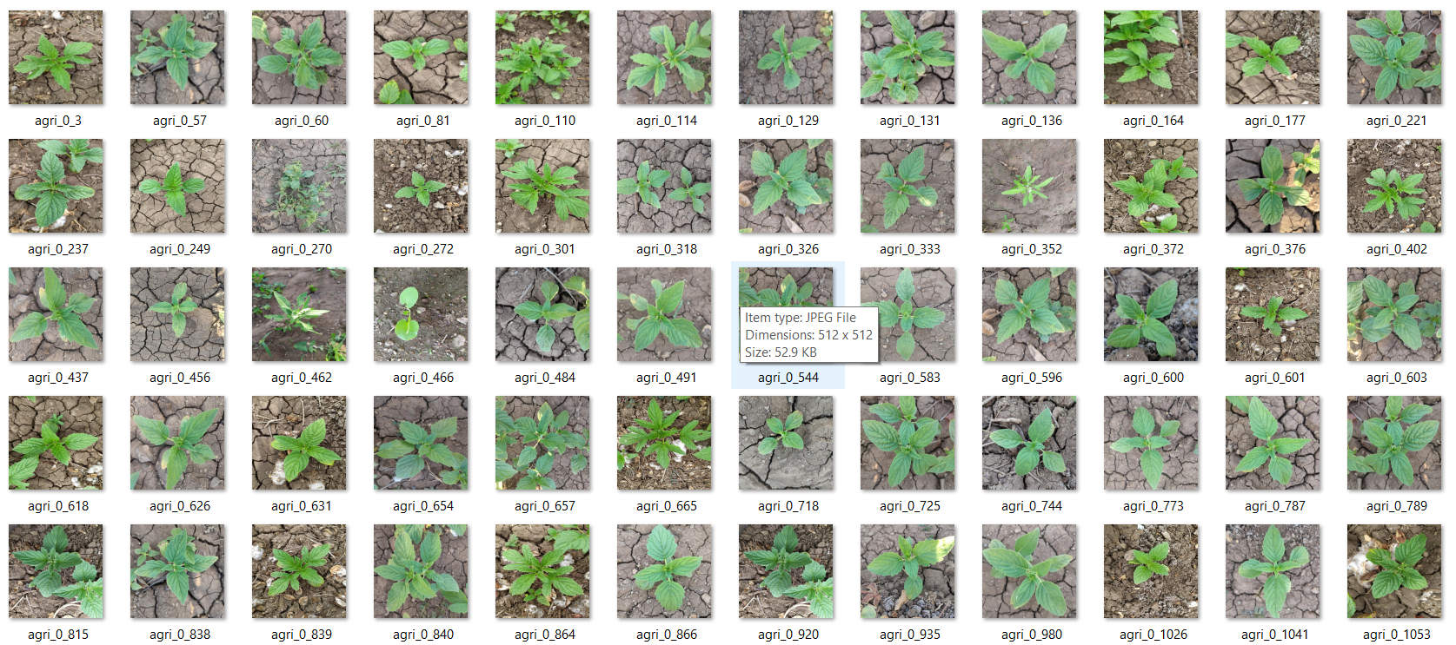
Sample Image of Training Dataset

Slide 11
Hardware Requirements
System : Intel core i3.
Hard Disk : 200 GB.
Monitor : 15 VGA Color.
RAM : 2 GB.
Software Requirements
Operating system :
Windows XP/7/10
Coding Language : python
Development Kit : anaconda
Library : TensorFlow, keras, OpenCV- CNN, VGG19
Dataset size :1046 Training Images (2 classes) & 600 Testing Images (2 classes)

Slide 12
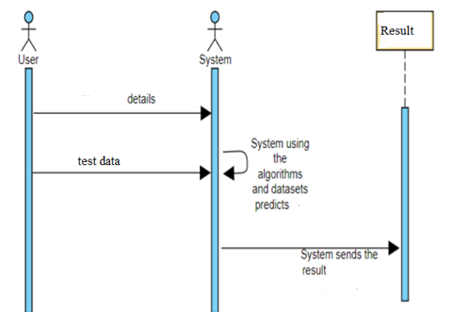
Sequence Diagram

Slide 13
Flask
Flask is a micro web framework written in Python. It is classified as a microframework because it does not require particular tools or libraries. It has no database abstraction layer, form validation, or any other components where pre-existing third-party libraries provide common functions.
Flask is easy to get started with as a beginner because there is little boilerplate code for getting a simple app up and running.

Slide 14
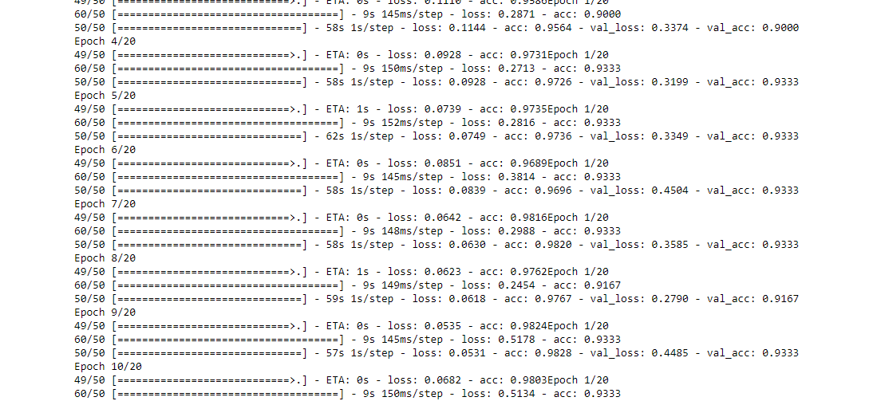
Training Process

Slide 15
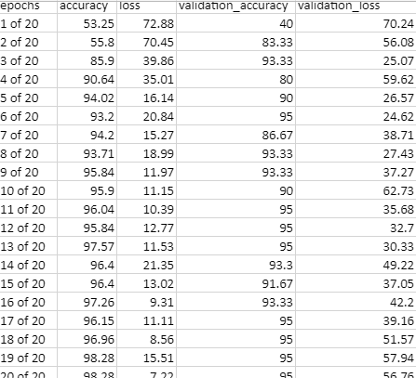

Model Accuracy
ADAM
RMSPROP
epochs | accuracy | loss | validation_accuracy | validation_loss
1 of 20 | 69.98 | 53.66 | 86.67 | 33.43
2 of 20 | 94.02 | 16.49 | 91.67 | 30.7
3 of 20 | 95.64 | 11.4 | 96 | 33.7
4 of 20 | 97.26 | 9.2 | 93.3 | 31.9
5 of 20 | 97.36 | 7.4 | 93.3 | 33.5
6 of 20 | 96.96 | 8.3 | 93.3 | 45.5
7 of 20 | 98.2 | 6.3 | 93.3 | 35.8
8 of 20 | 97.67 | 6.1 | 91.6 | 27.9
9 of 20 | 98.28 | 5.3 | 93.3 | 44.8
10 of 20 | 98.07 | 6.6 | 95 | 40.4
11 of 20 | 98.77 | 5.9 | 91.6 | 39
12 of 20 | 94.1 | 19.9 | 91.6 | 42.5
13 of 20 | 99.39 | 2.8 | 90 | 47.6
14 of 20 | 98.78 | 5.3 | 93.3 | 49.02
15 of 20 | 97.67 | 6.25 | 93.3 | 35.31
16 of 20 | 99.79 | 2.7 | 95 | 34.9
17 of 20 | 98.35 | 4.7 | 93.3 | 45.86
18 of 20 | 99.6 | 1.7 | 93.3 | 67.63
19 of 20 | 99.7 | 1.6 | 93.3 | 56.79
20 of 20 | 99.39 | 1.4 | 81.6 | 32.1

Slide 16
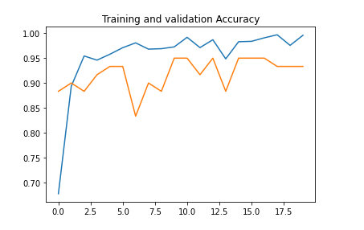
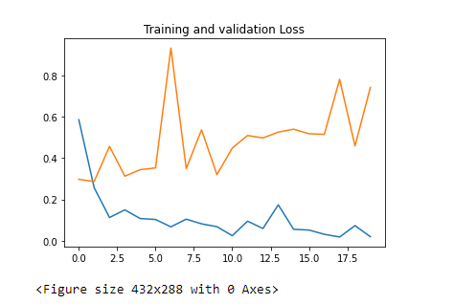
ADAM optimizer Graphs

Slide 17
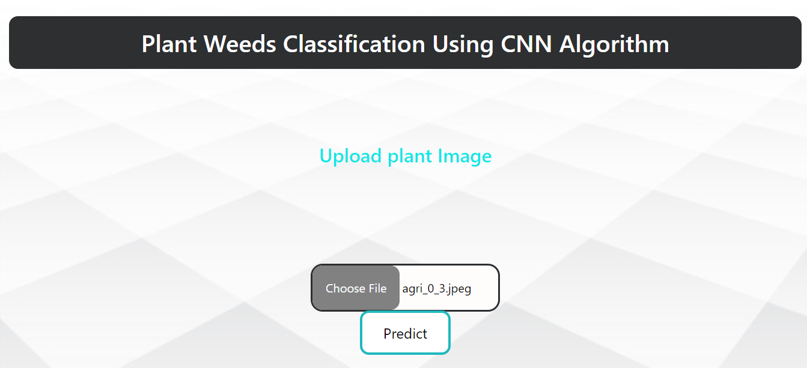
OUTPUTS

Slide 18
Conclusion
India is a cultured country and about 70% of the residents depend on agriculture. Farmers have large range of variety for select various suitable crops and finding the weeds of a plant. It can be improved by the aid of technological support.
By using this Identification tool, lots of money and time can be saved.
This identification technique reduces the amount of computation when compared to others.
Adaptation to such tools will help in the revolutionization of the farming industry.

Slide 19
References
[1] Al Bashish D,Braik M,Bani-Ahmad S (2010) ―A Framework for Detection and Classification of Plant Leaf and Stem Diseases.‖In:2010 international conference on signal and image processing, IEEE, Chennai, pp 113–119
[2] DongPixia,WangXiangdong(2012)―Recognitio n of Greenhouse Cucumber Disease Based on Image Processing Technology‖ Open Journal of Applied Sciences, 2013, 3, 27-31
[3] Huang KY (2007) ―Application of Artificial Neural Network for Detecting Phalaenopsis Seedling Diseases using Color and Texture Features.‖ Comput Electron Agric 57:3–11
[4] Wang H, Li G, Ma Z, Li X (2012) ―Application of Neural Networks to Image Recognition of Plant Diseases.‖In: Proceedings of the 2012 International Conference on Systems and Informatics (ICSAI). IEEE, Yantai, pp 2159–2164
[5] H.A1-Hiary, S.Bani-Ahmad, M.Reyalat, M,Braik and Z. ALRahamnesh ,"Fast and Accurate Detection and Classification of Plant Diseases‖ ,IJCA, Vol: 17-No.1 ,March 2011.Pg: No: 31-37
[6] https://www.kaggle.com/ravirajsinh45/crop-and-weed-detection-data-with-bounding-boxes

Slide 20

Thank you

